Slide 2
Customize Progressive Delivery for Your Own Workload and Traffic
Zhang Zhen & Mingshan Zhao, Alibaba Cloud

Slide 3
Outline
Progressive Delivery and Kubernetes Workload
Kruise Rollout: A Flexible and Pluggable Framework for Progressive Delivery
Scalable traffic scheduling solution
End-to-end progressive delivery solution for microservice application
OpenKruise Community Development

Slide 4
Progressive Delivery and Kubernetes Workload

Slide 5
What is Progressive Delivery?
Progressive Delivery, mainly differentiated from full/one-off releases
Characteristics of progressive delivery:
Incremental release process
Staged, canary verifiable
Pauseable, rollbackable, resumeable, automated state flow

Slide 6
Progressive Delivery improves efficiency and stability of releases
Community Types: Canary Releases, A/B Testing, Bluegreen Releases
Version X -> Version Y
New Version Y
No, Continue to the next batch
Start Release
Batch N Release:
Verify
Yes
Yes
Y become the online version
Instance Rollout:
Add Y number of instances
Traffic Scheduling：
Add gray traffic to y instances
Completion?
No
Rollback Instance and Traffic
X become the online version

Slide 7
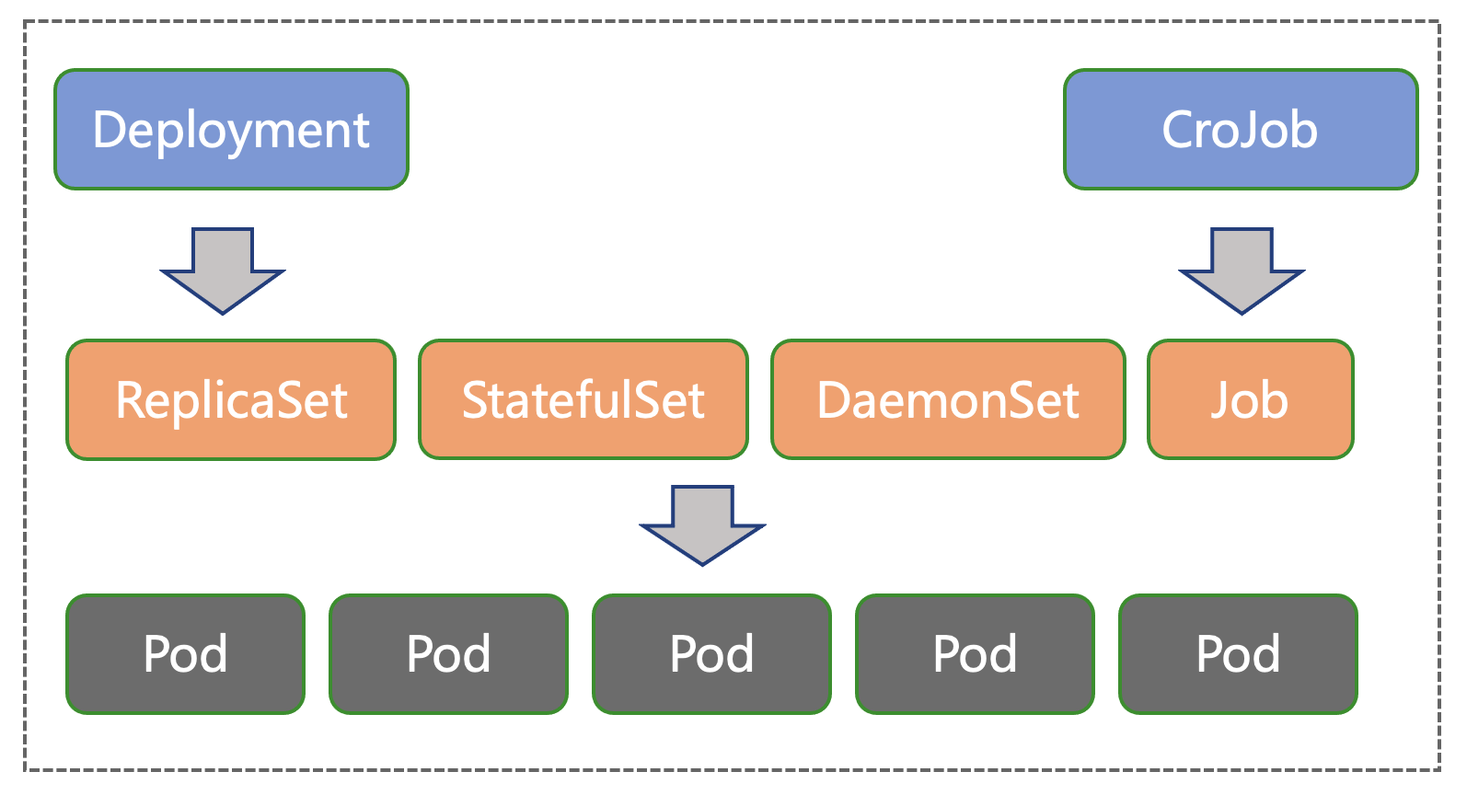
Kubernetes Workload
Deployment Rolling Update Strategy
maxUnavailable: Maximum number of unavailable Pods
maxSurge: Maximum number of scheduled above the desired replicas
StatefulSet Rolling Update Strategy
partition: Release [partition : replicas] Pods to new version
maxUnavailable(since v1.24 [alpha]): Maximum number of unavailable Pods
Summary
Deployment only support streaming release all pods
StatefulSet used to support only serial batches, but since v1.24 it has been possible to expand concurrency.
Kubernetes workload are only responsible for instance control, not traffic control

Slide 8
Kruise Rollout: A Flexible and Pluggable Framework for Progressive Delivery

Slide 9
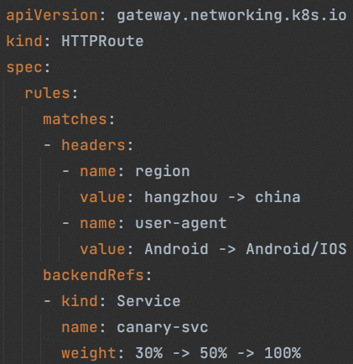

Why is Kruise Rollout?
Implementing Progressive Delivery in K8S is a very complex process that involves multiple components, configuration modifications, coordination
Progressive Delivery :
1 Pod, Hangzhou + Android user (labeled in Header)
10 Pods, Hangzhou + (Android or IOS) users
30 Pods, Nationwide + 30% traffic
50 Pods, nationwide + 50% traffic
100 Pods, Release Complete
Workload Update Strategy
Partition: 99 -> 90 -> 70 -> 50 -> 0
Ingress/Gateway API Configuration
Header/Weight/BackendRefs
Workload Controller
Who Coordinate?
Network Controller
V1 Pod
V2 Pod
Service
Canary Service
Weight: 30% -> 50% -> 100%
Weight: 70% -> 50% -> 0%

Slide 10
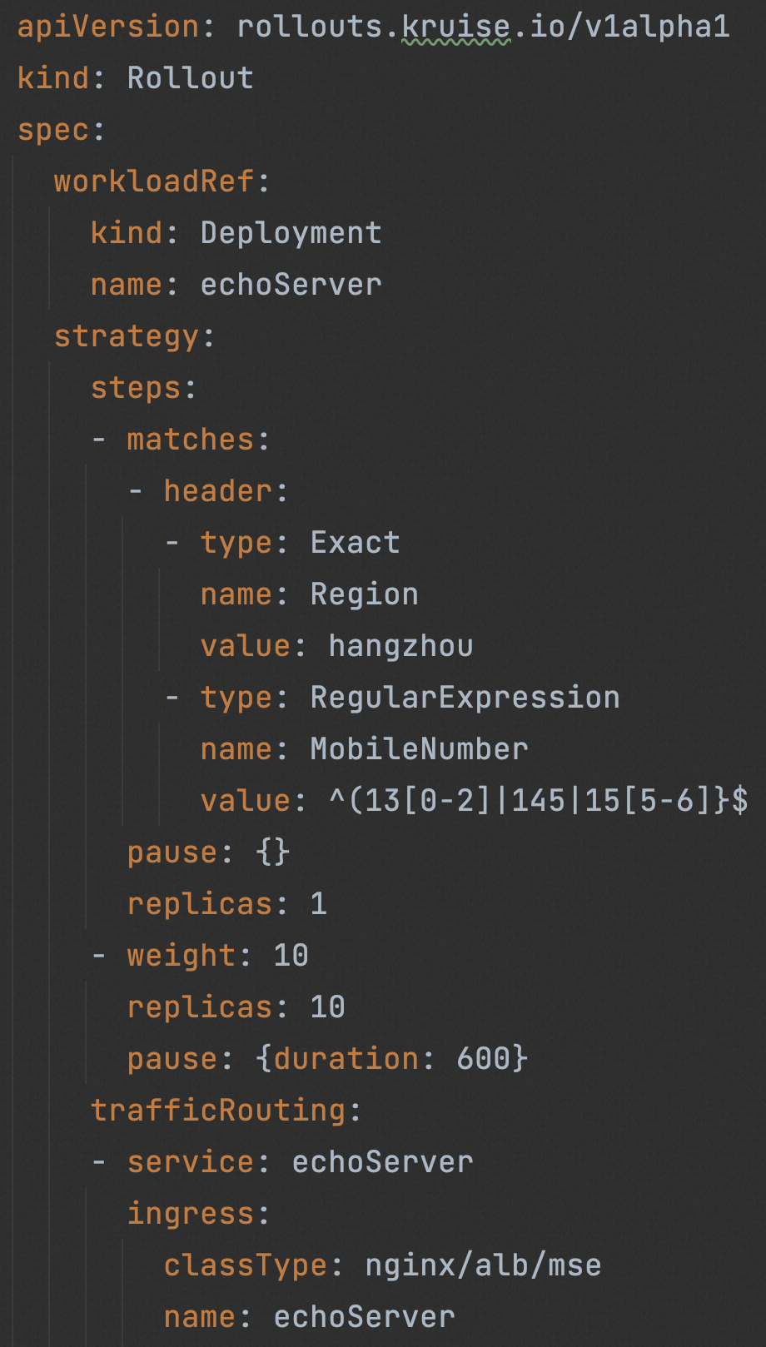
Simple, Standard API Definition
Associated Workload:
Bypassed, only name index
Deployment/StatefulSet/CloneSet/Ad DaemonSet
Progressive Delivery:
Multiple batch definition
Http header, cookies
Anded, Ored
Exact, Regular Expression
Manual confirmation, Automated
Traffic Weight, Replicas of new version pods
Associated Network Provider:
Bypassed, only name index
Ingress, Gateway API

Slide 11
A Flexible and Pluggable Framework for Progressive Delivery
Helm/OAM/Argo/Paas
Repeat 3, 4 to complete progressive delivery
User/Client
1. Application Release
User Access
K8S Master
2.1 Rollout Webhook Mechanism
Kruise Rollout
4.1 Dynamic adjustment of workload parameters
Ingress/Gateway
API Server
Controller
2.2 Pause Workload, and Partition=100%
4.2 Traffic Control
Workload Configuration
3.1 Dynamic adjustment of workload parameters
3.2 Batch Release
Gray Traffic: 20% -> 40% -> 60%
V1
V2
Service Canary
…
Service
First Batch
Second Batch
Base Traffic: 80% -> 60% -> 40%

Slide 12
Kruise Rollout's Core Competencies
Native Deployment API
Does not modify any user-defined resources
Support for Inventory Workloads
Non-intrusive
Multiple workloads, as well as customized workloads
Ingress (Alb, Nginx, MSE) and Gateway API
Customized Network Provider
Low cost of learning
Ready-to-use, Argo-cd, Helm, Kubevela, Paas
Diversity
Usability

Slide 13
Argo-cd-based Gitops Release Demo (4mins)
GitOps Echoserver Application, and have three tags:
gitops-demo-version-stable, Stable version
gitops-demo-version-v2
gitops-demo-version-failed
Scenario 1:
Stable -> v2
Canary + Batch Release
Scenario 1:
V2 -> failed
Fast Rollback

Slide 14
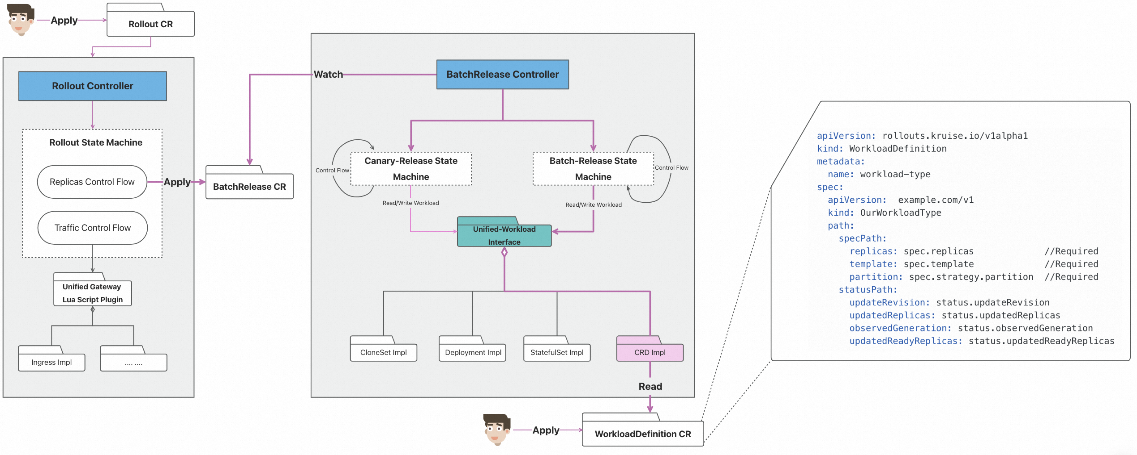
Customize your own workload
All workload with replicas, template, strategy.partition

Slide 15
Deployment In-place batch release capability
Deployment rolling update only support maxUnavailable and maxSurge, but not partition
Common community programs switch back and forth between two deployments, such as: flagger, kubevela
Weak Point:
Double resources during the release process
Deployment name change, not supported by many paas in the community, e.g. helm, argo-cd
Git Ops
K8S-API
webhook modify deployment strategy, pause=true
Kruise Rollout
Webhook
Deployment Controller
4. Recovery deployment strategy
2. controller don’t control RS
Deployment
Kruise Rollout:
Partition support for native deployments
No more Double resources and name changes during the release process
Fully compliant with the community Deployment's protocols, and can be taken back by the deployment after the release is complete
5. Deployment restores control over RS
3. Dynamic reconciliation of RS for batch release
ReplicaSet-X
ReplicaSet-Y
…
…
First Batch
Second Batch

Slide 16
Scalable traffic scheduling solution

Slide 17
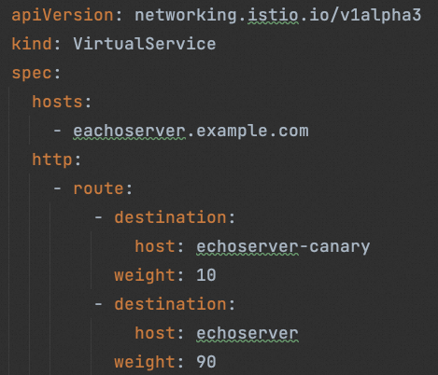
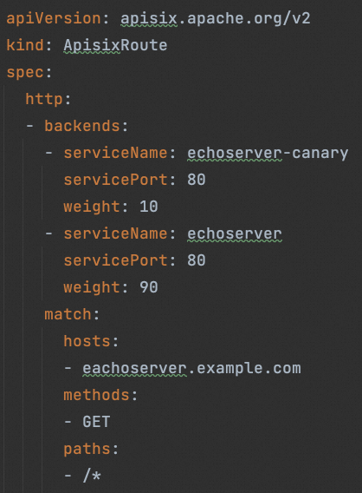
How to integrate community’s traffic resources?
There are many Network Gateways in the community
Nginx, Istio, Kong, Apisix …
How is Rollout compatible with each of these different implementations?
Community Programs：
Flagger, Argo-rollout integrated directly in the code one by one
Insufficient:
One by one, the integration is too much work
Can’t customize user own traffic resources

Slide 18

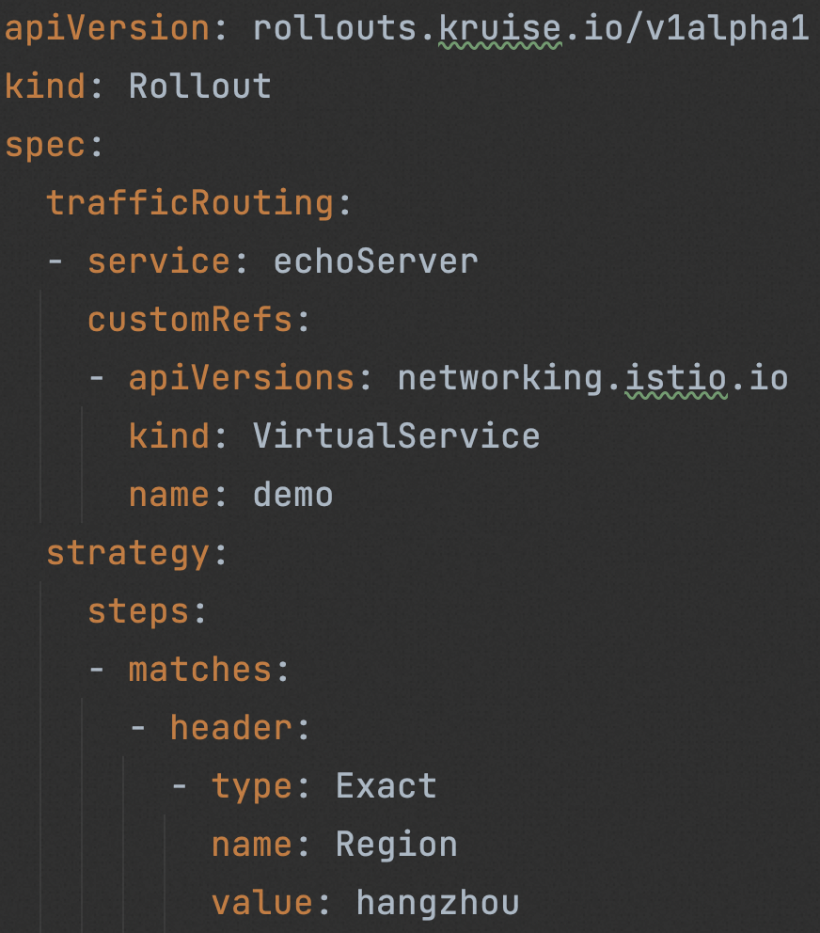
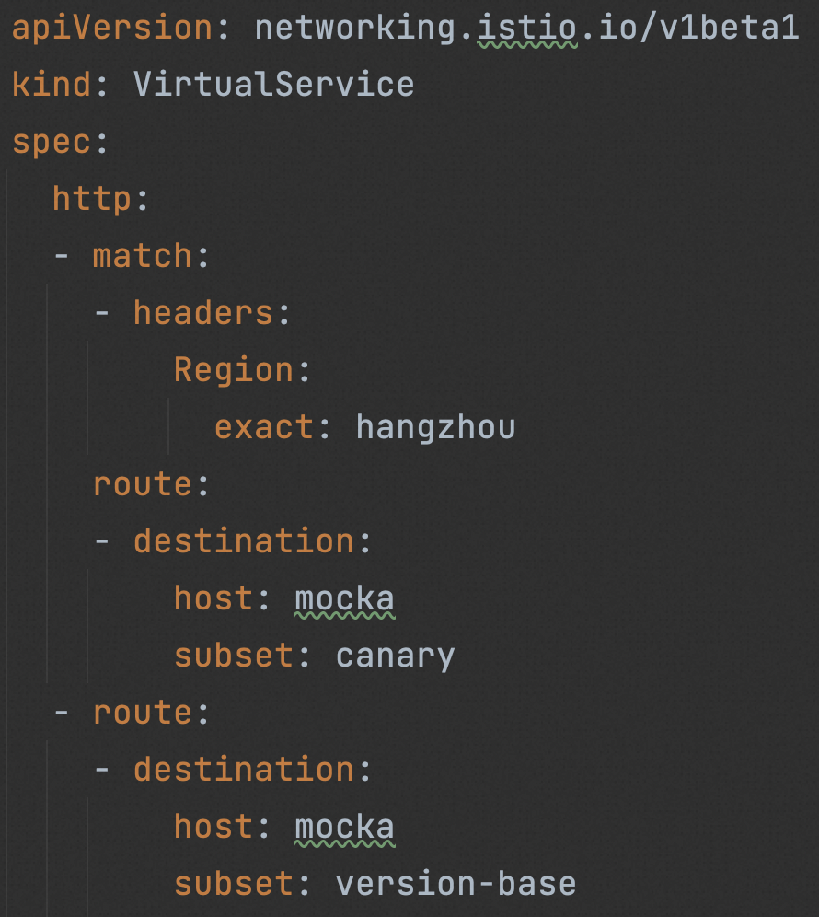

Traffic Scheduling Scheme Based on Lua Scripts
Traffic Controller
Custom Resources:
Istio, Apisix, Kong
Api Unstructured
1. Get unstructured object
2. Request rollout and unstructured object
Lua Manager
Lua Script Manager
Istio Lua Script
Apisix Lua Script
Kong Lua Script
3. New unstructured object
Api Unstructured
4. Patch unstructured object

Slide 19
Advantage of Lua scripts scheme
01
02
03
Good scalability
Easy integration
Low cost of learning
1. Any custom resource
Anyone may submit
No need to rebuild the image
Debug sample
Simple, Standard API Definition
Lua script syntax is simple

Slide 20
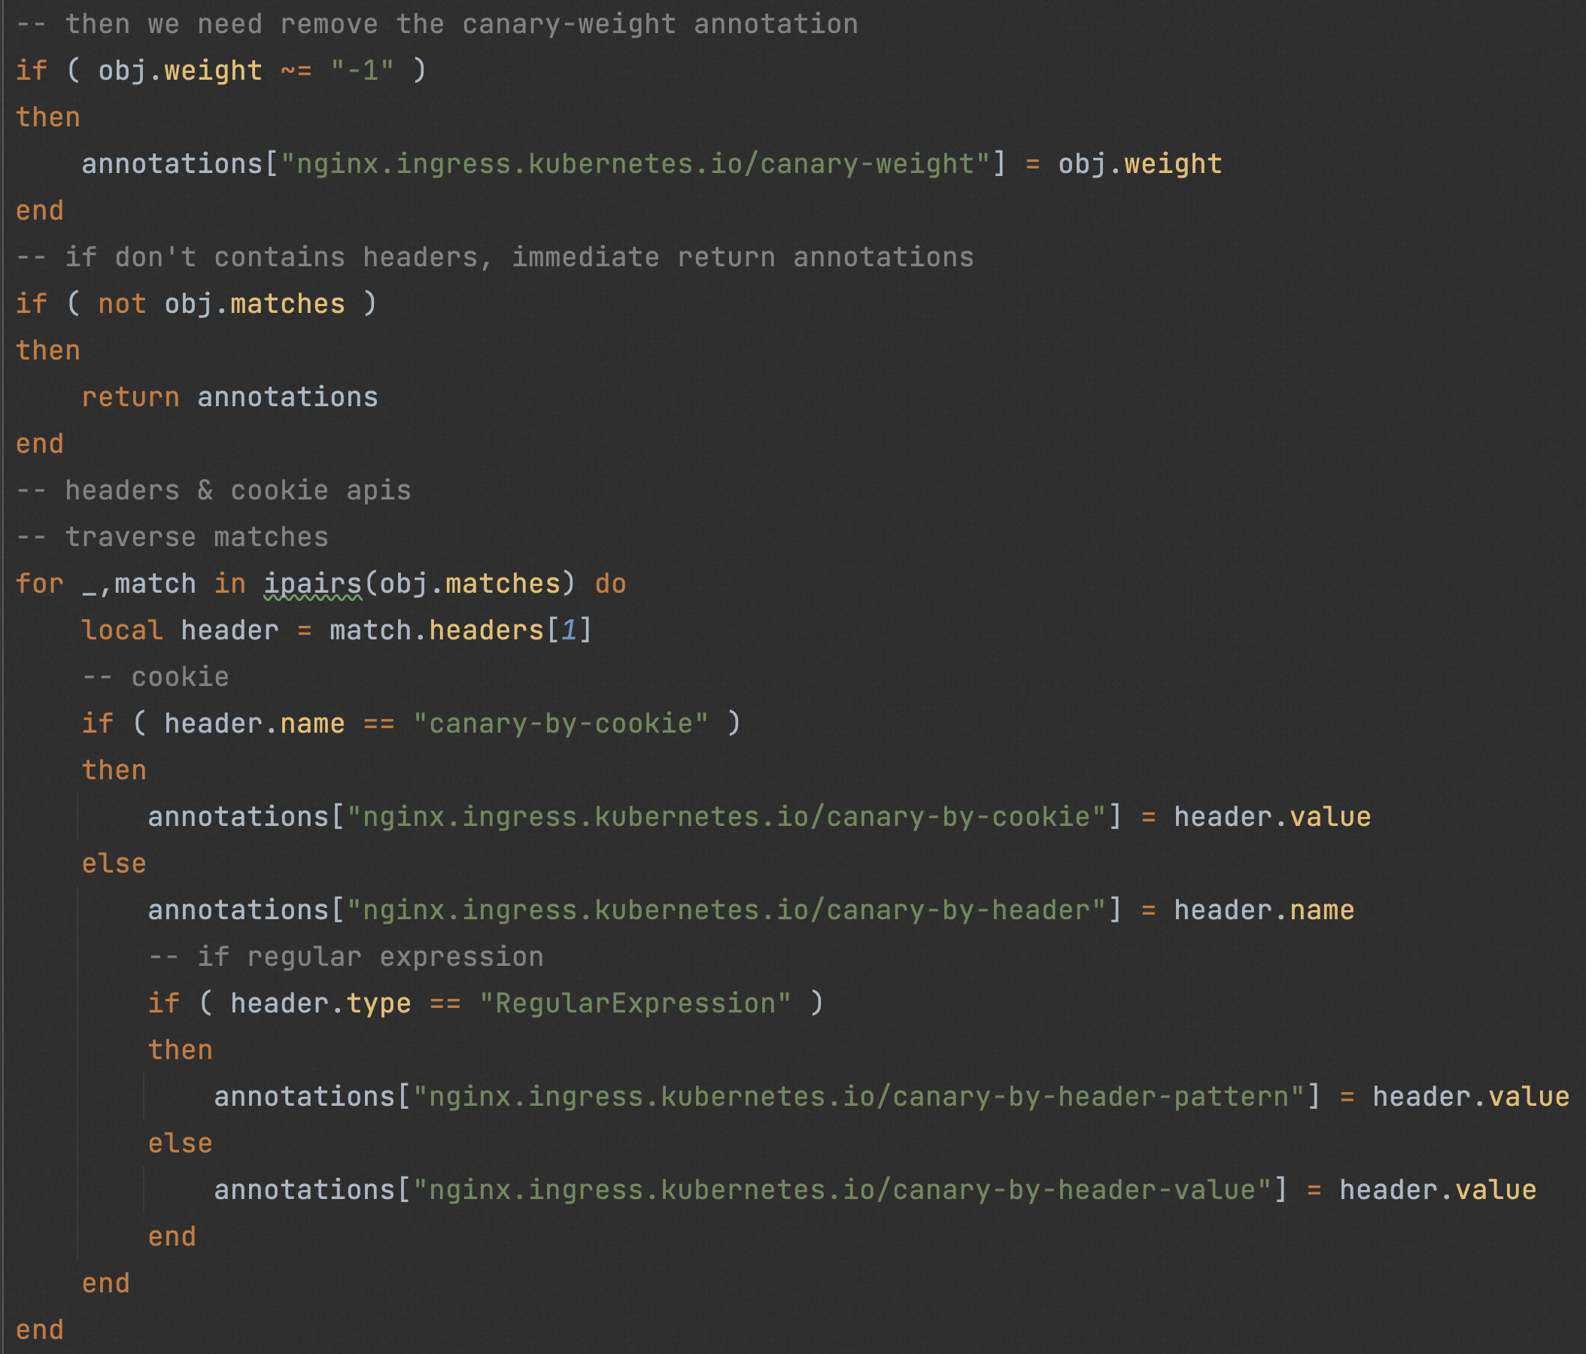
Customize your own traffic resources
Nginx Lua Scripts Demo
The community has complete documentation and mechanisms to help people integrate custom traffic resources
Integration Documentation and Demos
Lua scripts: table, function, ipairs, etc.
UT, and Debug
For Community General Traffic:
You can submit to community repo
Lua scripts will be placed in the Release Image
Participate in community building and be accessible to all
For custom own traffic resources:
Defined in configmaps
No need to rebuild the image

Slide 21
End-to-end progressive delivery solution for microservice application

Slide 22
Microservices place higher demands on
progressive delivery
Service A
Service C
Gateway
Service A’
Service C’
Gateway
Service B’
Service C
Service B
Microservice call links are long and complex
A gray scale may involve multiple modules, the entire link has to call the new version
Multiple projects in parallel, need to deploy multiple environments, environment construction is not flexible, high cost
The traditional incremental release model cannot meet the complex and diverse scenarios of microservice delivery

Slide 23
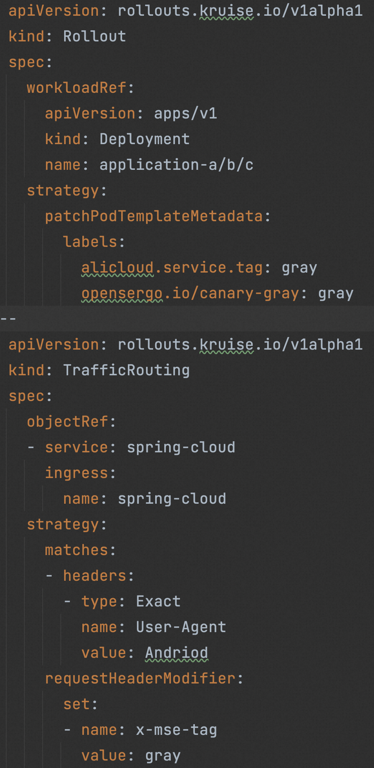
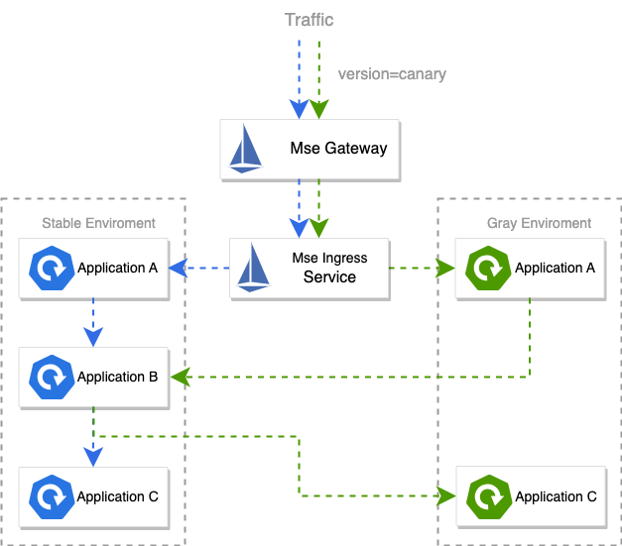
End-to-end progressive delivery solution

Slide 24
Rollout + Mse End-to-end progressive delivery
User
Gateway
A
B
C
gray
gray
TopicA (gray)
iOS
A
C
Agent
Agent
gray
gray
userid:120
Mse Gateway
gray
Android
userid:100
base
A
base
B
C
H5
Agent
Agent
base
Agent
base
base
gray
TopicA
(base)
Message
Message
Message
Static file
Static file
SQL 92 filter
Message
Html/Css/Js
RocketMQ Server

Slide 25
OpenKruise Community Development

Slide 26
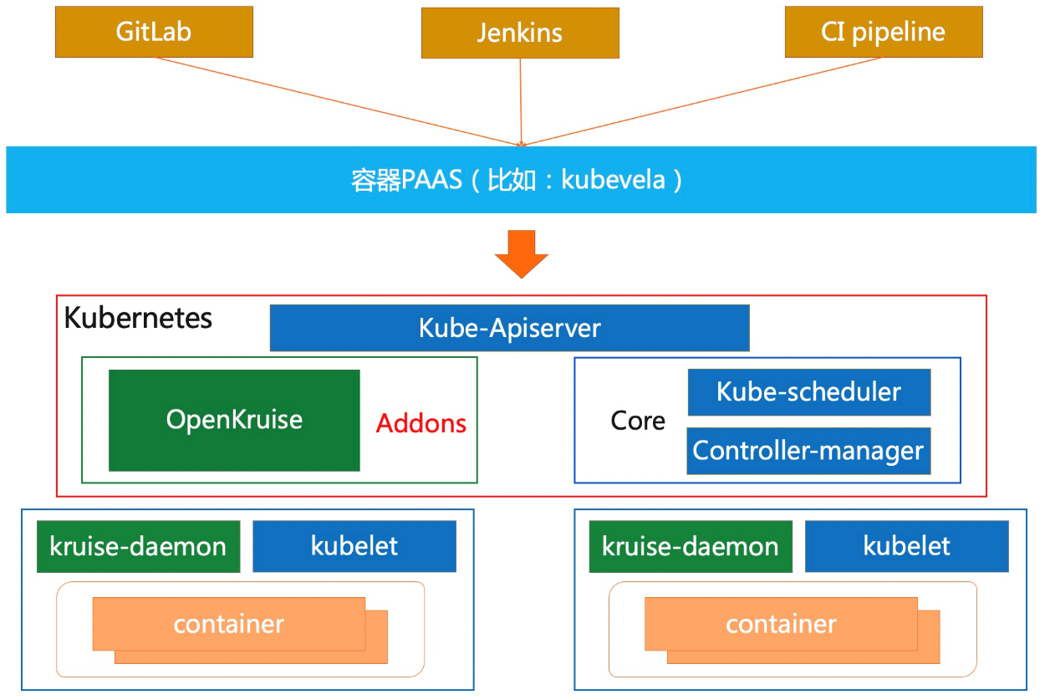
What is OpenKruise?
Extended Application Management Components Based on Kubernetes
Can run in any native kubernetes cluster
Paas (Argo-cd/kubevela)

Slide 27
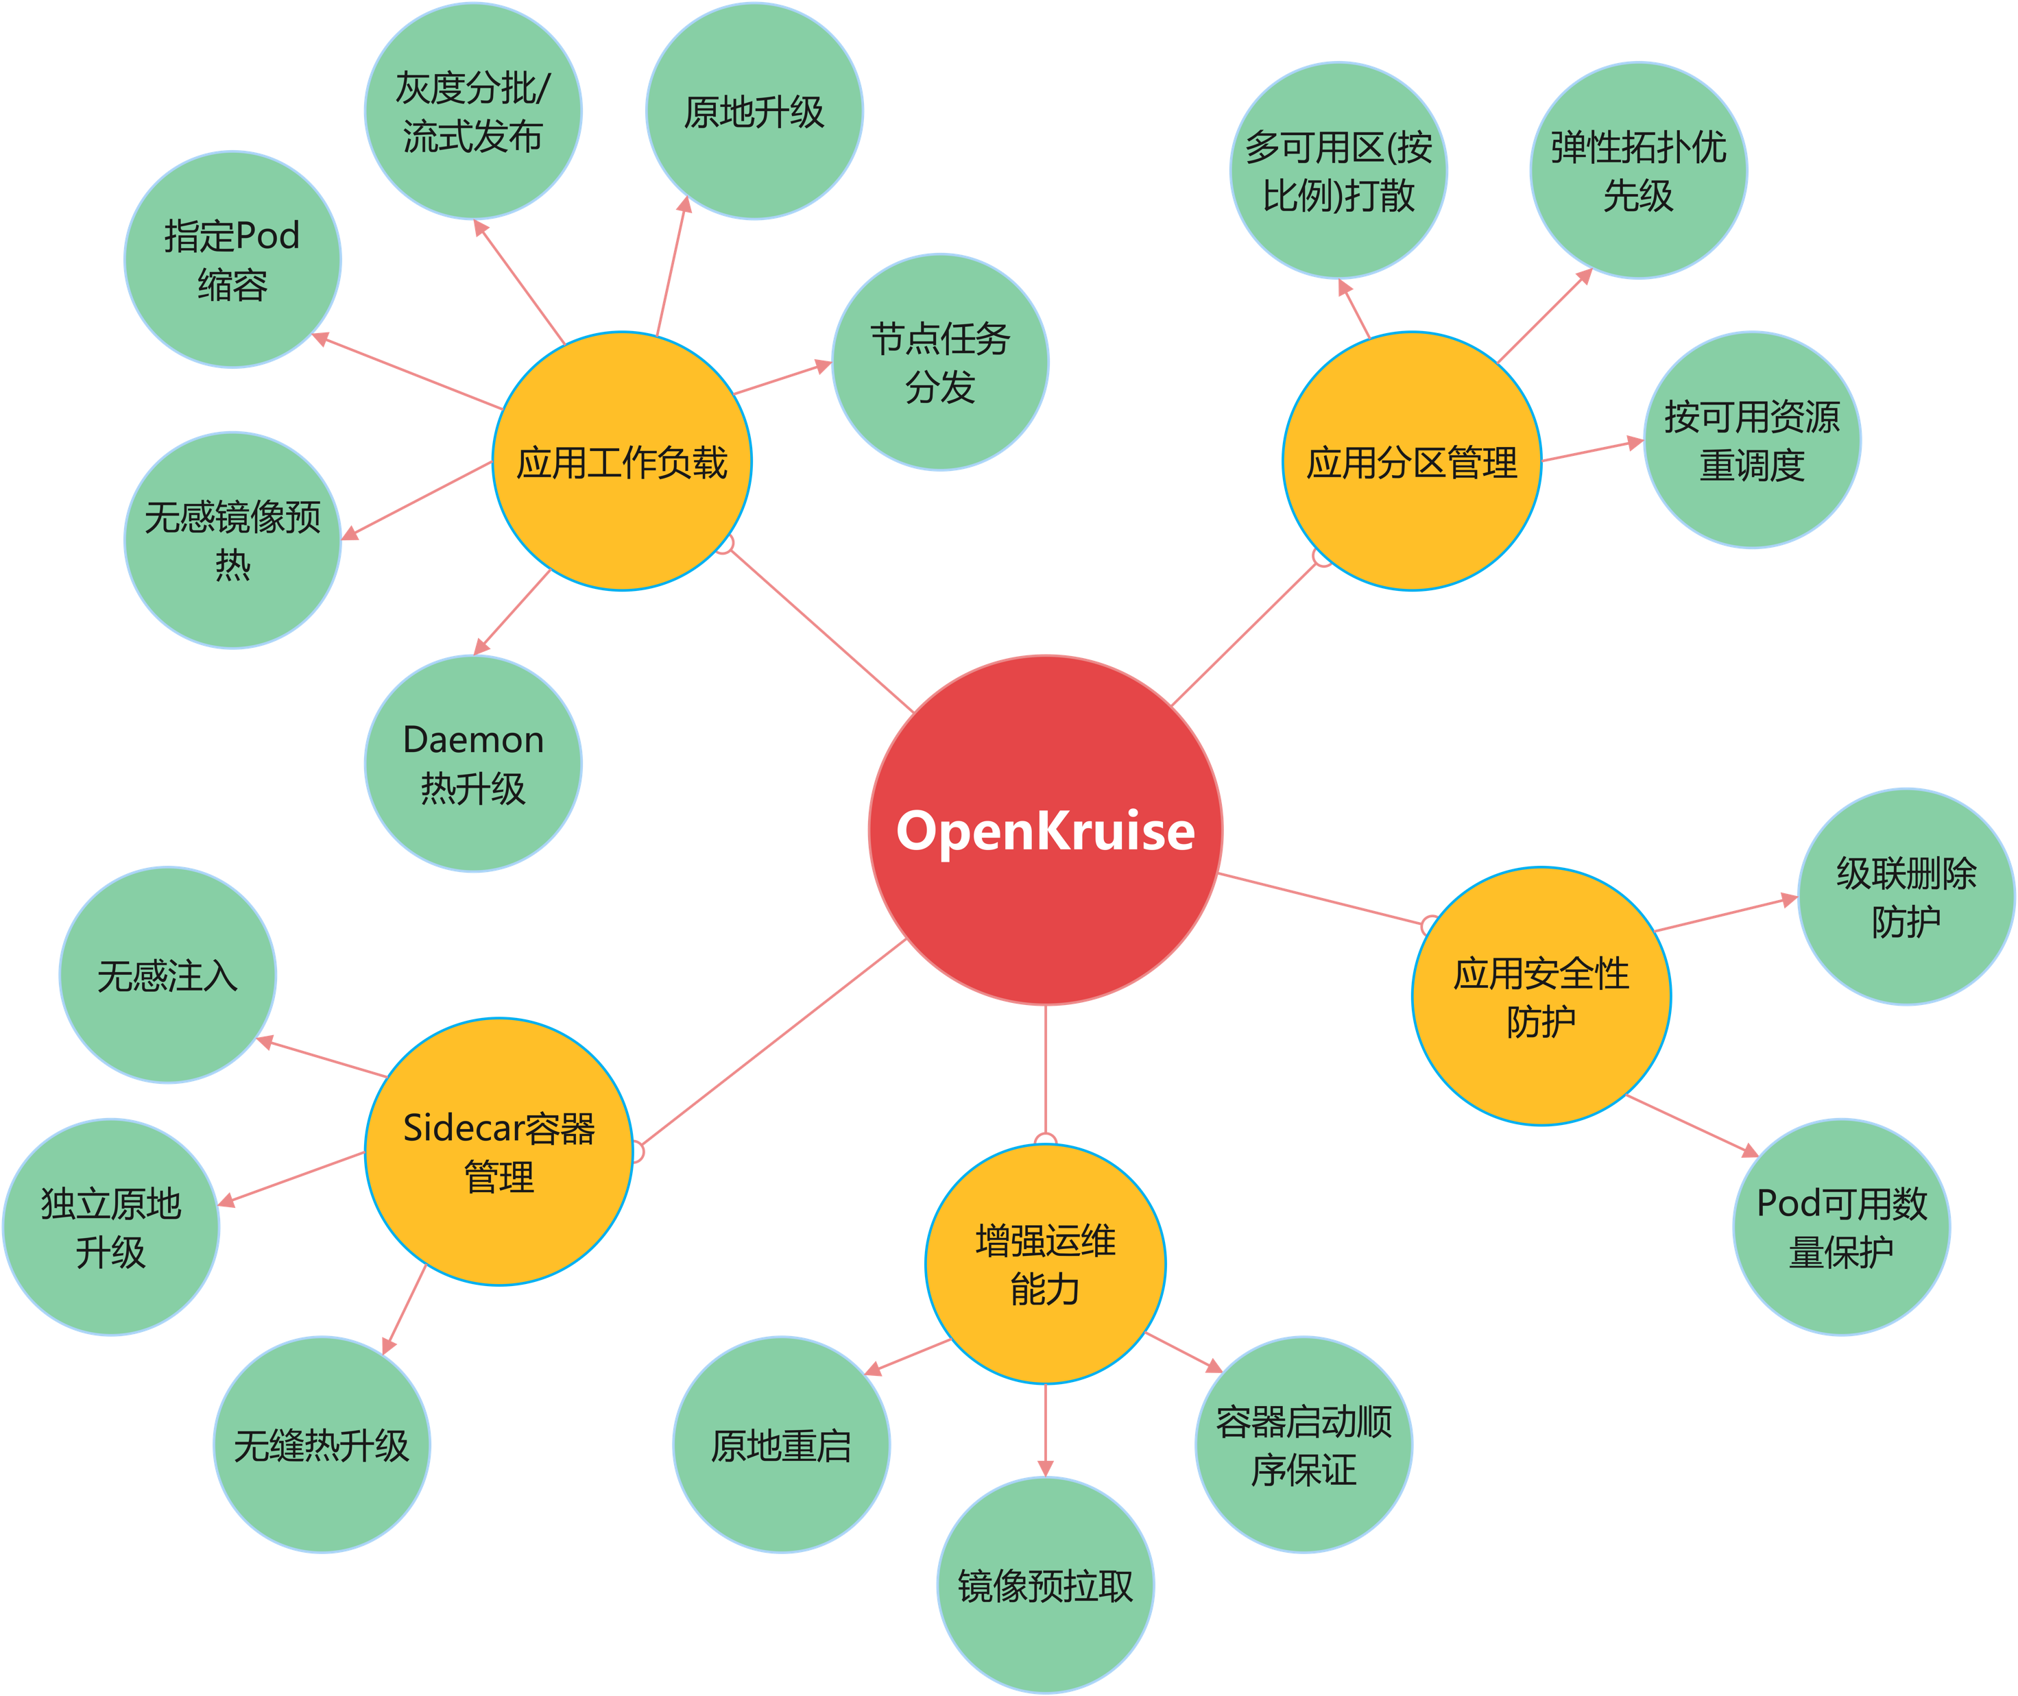
What are the capabilities of OpenKruise?
Areas of specialization:
Enhanced Workloads
Sidecar container management
Application Partitioning Management
Availability Protection
New area:
Progressive Delivery
OpenKruise Game

Slide 28
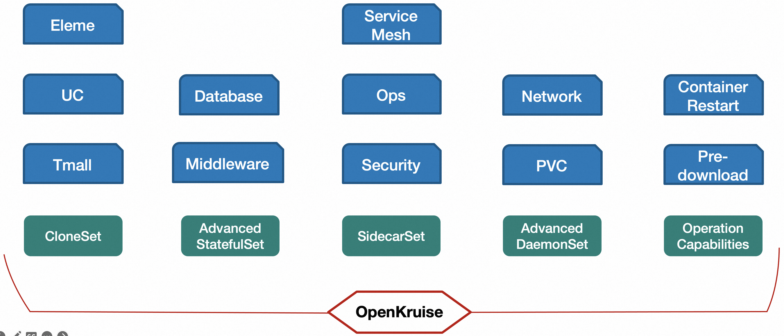
Kruise is Alibaba's application management base

Slide 29

Community Development
Star: 4k+
Contributor: 190+
Rank Companies: 50+ (Baidu, Xiaomi, Lilith, Meituan, etc.)
2019.7 (v0.1) -> 2023.9 (v1.5.0)
2022 Entering CNCF Incubation
Expected 2023.12 Release 1.6 (includes: in-place upgrade to support VPA)
Kruise Rollout (future planning):
Support for Analysis Prometheus Metrics
OpenKruise (future plans):
Support for global LivenessProbe probes
CloneSet/StatefulSet support Resources In-Place Upgrade
Exit Prioritization Capability Open Source
Wechat Group: openkruise
Dingding Group

Slide 30
Q & A

